Slide 1
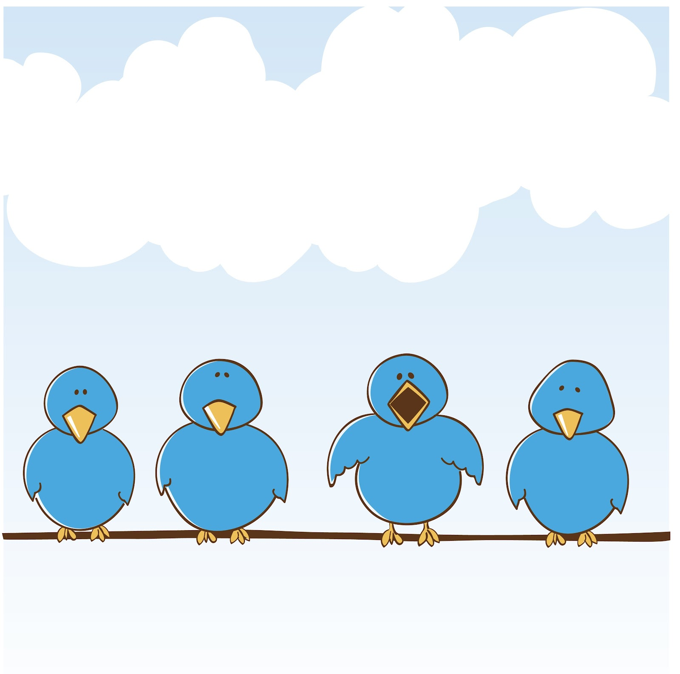
REVIEW UNIT 1-2-3

Slide 2
I. Choose the words whose underlined part is pronounced differently from that of the others in each group.
1. A. gym B. sky C. balcony D. laundry
2. A. island B. seafood C. serve D. summer
3. A. information B. population C. question D. transportation
4. A. live B. listen C. think D. write
5. A. speaking B. teaching C. cleaning D. wearing
II. Choose the word whose main stressed syllable is placed differently from that of the other in each group.
1. A. center B. basement C. garage D. kitchen
2. A. machine B. laundry C. dinner D. shopping
3. A. delta B. canal C. country D. hometown
4. A. balcony B. temperature C. restaurant D. apartment
5. A. museum B. attention C. secondary D. possession

Slide 3
III. Fill in the blanks using the words in the box.
1. My mother goes to the__________ twice a week. 2. A__________ is in the countryside and usually has a few houses.
3. Does your apartment have a__________? 4. Did you park the car in the__________? 5. A: Does your house have a big__________?
6. B: Yes, it does. We plant trees and__________ there. 7. We asked for a hotel room with a__________. 8. Our__________ is small and has two bedrooms.
9. A__________ has many big buildings, schools, parks and hospitals.
balcony | village | yard | garage | city | pool | flowers | gym | apartment

Slide 4
IV. Read the sentences and underline the correct answers
1. My sister often makes breakfast/ dinner in the morning.
2. The plates are dirty. I need to do the shopping/ dishes.
3. Jenny makes breakfast/ does the dishes after eating lunch.
4. Let’s clean the bathroom/ eat breakfast. It’s so dirty.
5. My mom do the shopping/ laundry. My clothes are always really soft.
6. We’re out of juice. Can you buy some when you do the laundry/ shopping?

Slide 5
I. Underline the correct words. 1. My favorite sport is tennis. What’s mine/ yours?
- I like soccer. 2. I found a bag. Is it mine/ yours?
- No, it isn't. My bag is here. 3. This book isn't my book. Mine/Yours is blue. Is it yours?
- Yes, it is.
4. I saw a red hat on the table. Isn't yours/mine red?
- No, mine is blue. 5. What's your favorite ice cream? Mine/Yours is chocolate.
- I like chocolate, too. 6. Do you have a ruler? Mine/Yours is at home.
- Sure, here you are

Slide 6
III. Fill in the blanks using the phrases in the box.
1. I want to go shopping to buy some winter clothes. 2. Let's__________. I want to go shopping and there's a great restaurant there, too. 3. It's a beautiful day! Let's__________ and swim in the sea. 4. She's going to__________. It's going to have cheese and tomato on it. 5. Let's__________ at the movie theater. 6. I usually__________ with my friends at school. I can hit the shuttlecock really hard. 7. My sister and I always__________ after dinner. We really like cartoons. 8. I like to__________ with my friends. My mom only lets me play after I finish my homework. 9. I have milk, flour, eggs, and sugar. Let's__________. 10. He's going to__________ for his birthday. I need to get him a gift. 11. It's a lovely day. Let's__________ in the garden. It will be delicious! 12. I like to__________ at the beach when it's sunny.
watch TV | have a barbecue | make a cake | have a party
watch a movie | play video games | play badminton | go swimming
go shopping | make a pizza | go to the beach | go to the mall

